Slide 1
COMPUTER SYSTEM
4110E206 歐跟莎
MY DEAR GREAT TEACHER

Slide 2
AGENDA
Computer System
Von Neumann Architecture
Computer hardware
Memory Hierarchy What is RAM? ROM? Differences between the two What is SRAM? DRAM? Differences between the two
Computer software: Operating system

Slide 3

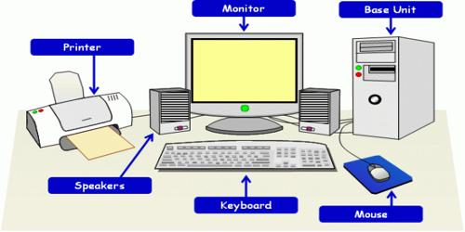
COMPUTER SYSTEM

Slide 4
WHAT IS A COMPUTER SYSTEM?
An integrated group of devices known as a computer system may input, output, process, and store data and information. Currently, computer systems are constructed around at least one digital processor.
A computer system's input, processing, storage, output, and communication devices are its five basic hardware constituents.

Slide 5
MAJOR TYPES OF COMPUTER SYSTEM
Microcomputer System
Multimedia Computer System
Midrange Computer System
Mainframe Computer System
Supercomputer System

Slide 6
MICROCOMPUTERS SYSTEM
For end users, microcomputers are the most significant class of computer systems. Even though they are frequently referred to as personal computers, or PCs, microcomputers are considerably more than just miniature computers for use by one person. Microcomputers today have more computing capability than the mainframes of earlier computer generations, and they are much less expensive. As a result, they have evolved into potent networked professional workstations for end users in the workplace. Microcomputers are used for a wide range of tasks and come in a variety of sizes and designs. PCs, for instance, come in handheld, notebook, laptop, portable, desktop, and floor-standing variations. Or, depending on their intended usage, they might be classified as multi-user, workstation, personal, professional, or home systems.

Slide 7
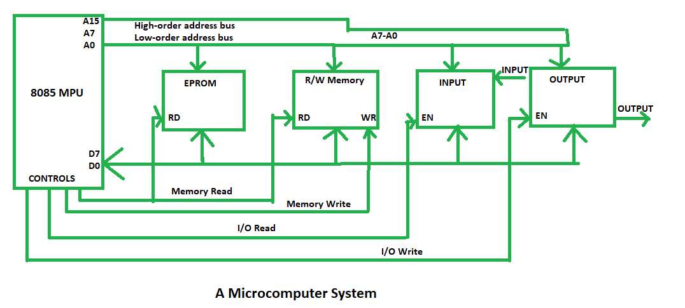
MICROCOMPUTER SYSTEM

Slide 8
Examples for Microcomputer System
Laptops and desktop computers are typical microcomputers. Microcomputers are devices other than traditional PCs, such as various types of calculators, mobile phones, laptops, workstations, and embedded systems. A microcomputer uses a single integrated semiconductor chip as its central processor unit and is smaller than a mainframe or minicomputer (CPU).

Slide 9
Multimedia Computer System
Information can be presented to you using a number of media on multimedia PCs, including text and graphic displays, voice and other digitized sounds, images, animation, and video clips. When you mention multimedia, many people immediately conjure up images of online multimedia home sites, educational films, multimedia encyclopedias, and computer video games. However, multimedia systems are frequently employed in business for customer education, sales presentations, employee training, and enhancing the impact of other corporate presentations.

Slide 10
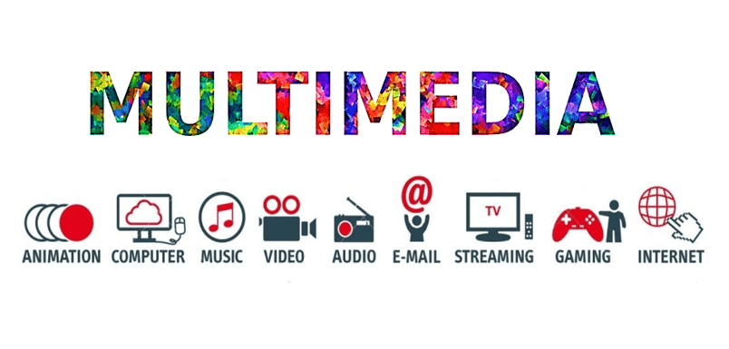
Multimedia Computer System

Slide 11
Examples for Multimedia Computer System
Computer games, computer-assisted design, home improvement software that enables users to plan and show a proposed project in three dimensions, flight simulators, and crash simulation for accident investigation are a few examples.

Slide 12
Midrange Computer System
Midrange computers, which can handle a network of PCs and terminals, include minicomputers and high-end network servers. Despite not having the same computational capability as mainframe computers, they are less expensive to purchase, run, and maintain than mainframe systems, meeting the computing requirements of many enterprises. Due to their limited scope and lack of need for mainframe systems' processing capabilities, these uses are suitable for minicomputers. So midrange computers still play a significant part in computer-aided manufacturing and are used for industrial process control and manufacturing plant computers (CAM). They can also come in the shape of potent technical workstations for CAD and other applications that require plenty of processing and graphics.

Slide 13
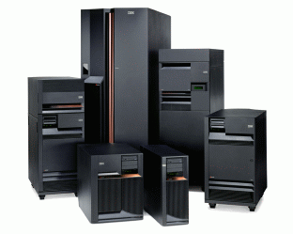
Midrange Computers System

Slide 14
Example for Midrange Computer System
Midrange computers come in a very wide variety and fill the space between mainframes and high-end PC servers in terms of processing power. For instance, IBM's Power Systems are its midrange line and are suitable for both commercial and research applications.

Slide 15
Mainframe Computer System
Large, quick, and potent computer systems are known as mainframe computes. For instance, mainframes are capable of processing hundreds of millions of instructions each second (MIPS). Additionally, mainframes have a lot of primary storage space. Their primary storage space can be anything between several gigabytes and hundreds of megabytes in size. And during the past few years, mainframes have significantly shrunk, lowering their need for air cooling, their need for electricity, their need for floor space, and consequently their purchase and maintenance expenses. The majority of these advancements are the result of switching from mainframes with water cooling to those with innovative CMOS air cooling technologies.

Slide 16
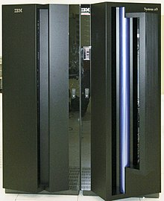
Mainframe Computer System

Slide 17
Examples for Mainframe Computer System
The universal automated computer from the UNIVAC series and the ZSeries mainframe computer from IBM are two examples of mainframe computers. Another illustration is a product made by Hewlett Packard called Non-Stop.

Slide 18
Supercomputer System
The word "supercomputer" refers to a class of incredibly powerful computer systems created especially for scientific, engineering, and commercial applications that demand exceptionally high speeds for extremely large-scale numerical computations. Large universities, significant enterprises, and government research organizations all participate in the supercomputer market. They employ supercomputers for tasks including large-scale data mining, military defense systems, computational cosmology and astrophysics, and research and creation of microprocessors. Supercomputers employ microprocessors coupled in parallel processing systems (which can execute many instructions at the same time in parallel). They are capable of doing billions of floating-point operations per second in arithmetic calculations (gigaflops).

Slide 19
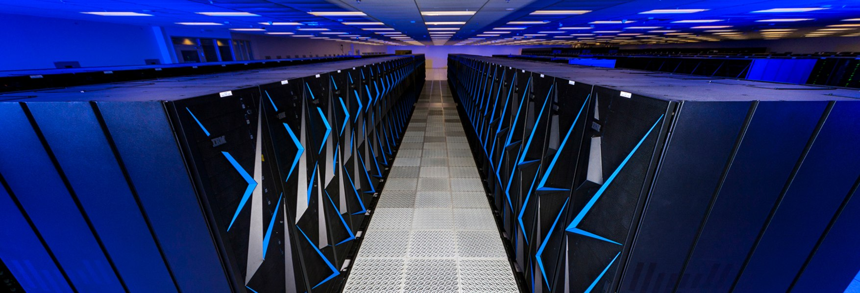
Supercomputer System

Slide 20
Examples for Supercomputer System
The chess playing supercomputers Belle, Deep Blue, and Hydra are examples of special-purpose supercomputers. Astrophysics supercomputers Gravity Pipe, MDGRAPE-3, Deep Crack, and MDGRAPE-3 are further examples.

Slide 21

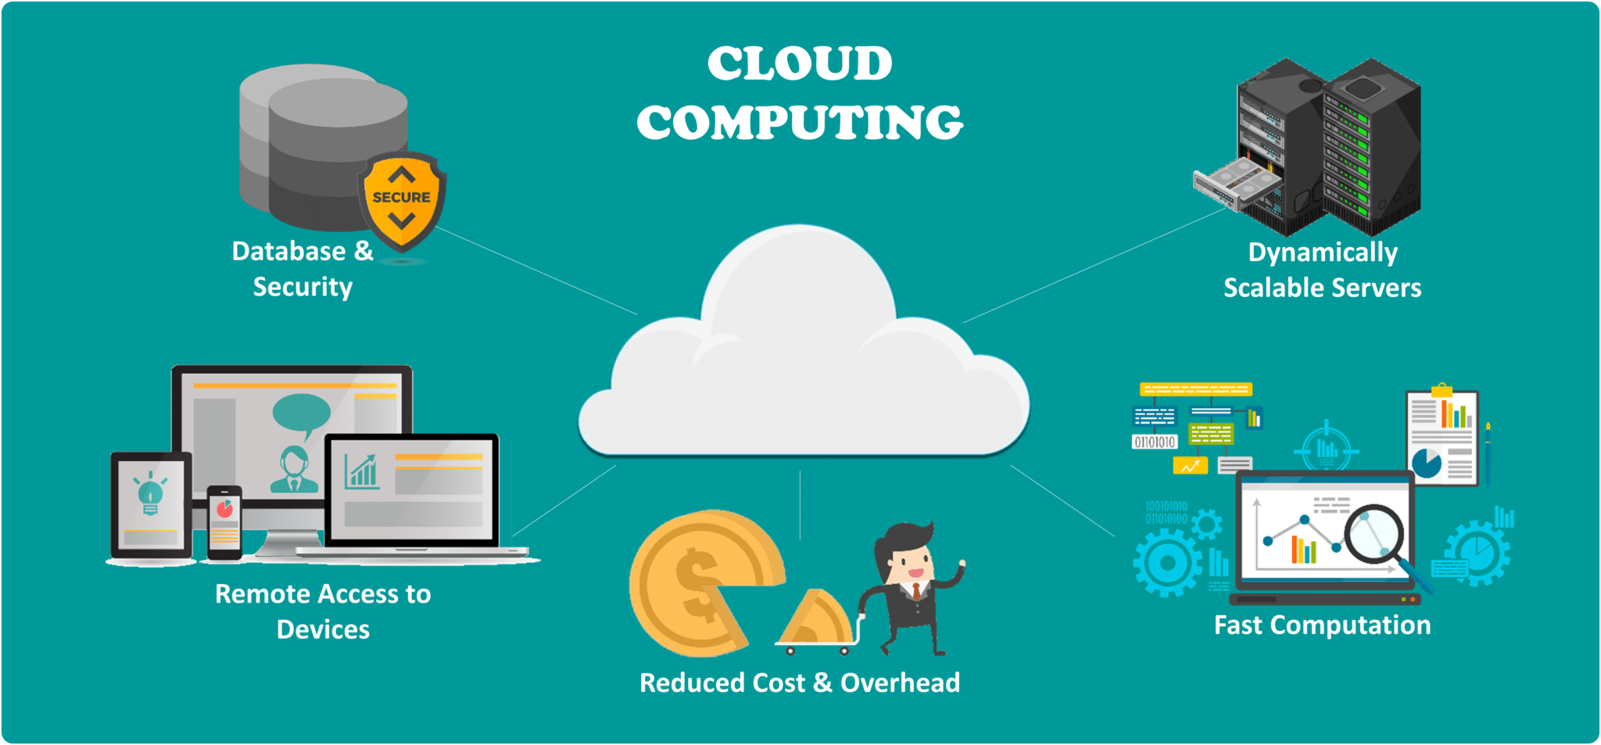
GOOGLE CLOUD

Slide 22
GCP stands for Google Cloud Platform
The Google Cloud Platform (GCP) is a collection of cloud services that provides internal networks, VPN connections, disk storage, SaaS (Software as a Service) applications written in machine language, and even something called TPU (Tensor Processing Units).Again, Google gives its machine learning tools a new moniker, but neither Google nor Amazon created this technology. The same Intel 8086 architecture is used by servers in Amazon and Google's data centers. Their differences are in their pricing, features, and customer service.

Slide 23
What does the GCP do?
In addition to cloud management, security, and developer tools, Google Cloud provides services for computing, storage, networking, big data, machine learning, and the Internet of Things.

Slide 24
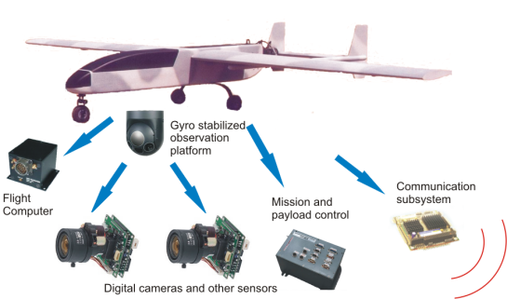
UAV

Slide 25
UAV – Unmanned Aerial Vehicle
Unmanned aerial vehicles, or drones, are aircraft without a human pilot, flight crew, or passengers. UAVs are a part of an unmanned aircraft system, which also includes a controller on the ground and a communications network for the UAV.

Slide 26
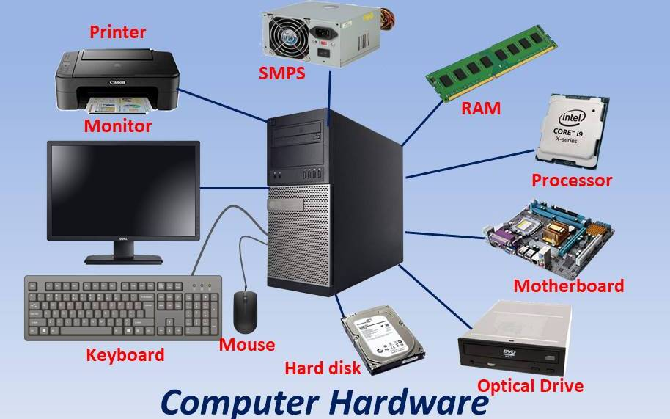
COMPUTER HARDWARE

Slide 27
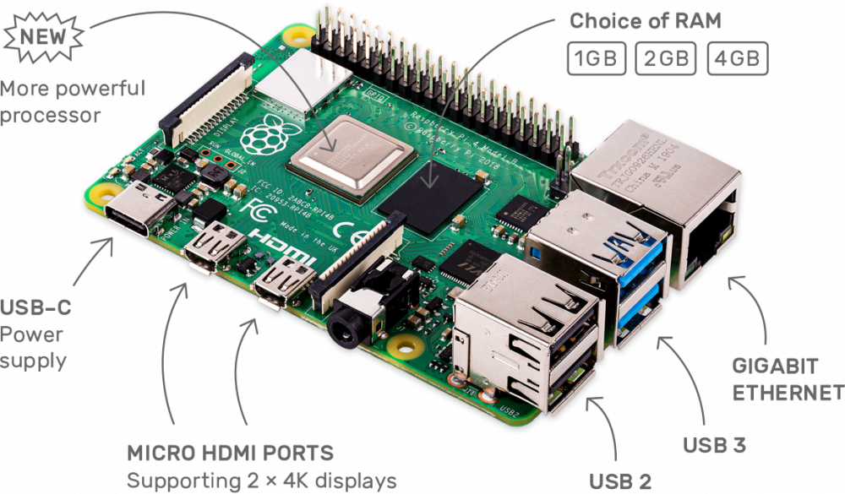
Computer Hardware Raspberry Pi 4

Slide 28
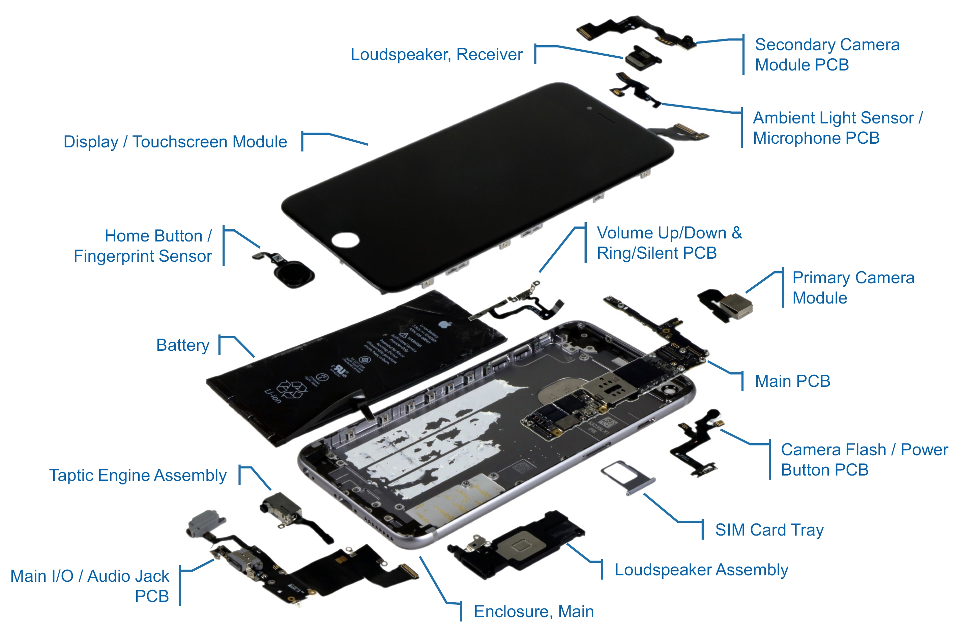
Computer Hardware Iphone
MY DEAR GREAT TEACHER

Slide 29

Computer Hardware Von Neumann Architecture
MY DEAR GREAT TEACHER

Slide 30
Von Neumann Architecture
The 1945 First Draft of a Report on the EDVAC by John von Neumann and others served as the basis for the von Neumann architecture, sometimes referred to as the von Neumann model or Princeton architecture. The following components of the design architecture for an electronic digital computer are described in the document: a processing unit containing both processor registers and an arithmetic logic unit a control unit with a program counter and an instruction register memory for storing information and command sauxiliary mass storage mechanisms for input and output.

Slide 31
Von Neumann Architecture
Von Neumann
(/vɒn ˈnɔɪmən/; Hungarian: Neumann János Lajos, pronounced [ˈnɒjmɒn ˈjaːnoʃ ˈlɒjoʃ]; December 28, 1903 – February 8, 1957) was a Hungarian-American mathematician, physicist, computer scientist, engineer and polymath. He was regarded as having perhaps the widest coverage of any mathematician of his time^{[13]} and was said to have been "the last representative of the great mathematicians who were equally at home in both pure and applied mathematics". He integrated pure and applied sciences.
MY DEAR GREAT TEACHER

Slide 32
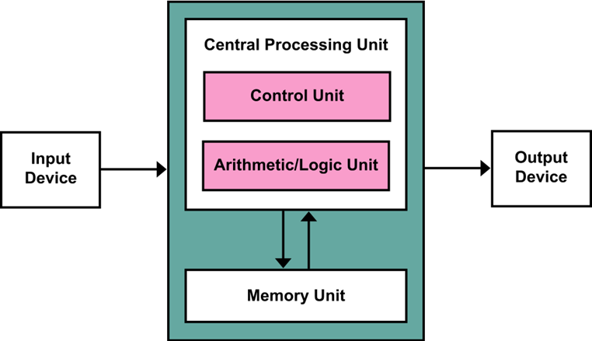
Von Neumann Architecture
The term "von Neumann architecture" has evolved to refer to any stored-program computer in which an instruction fetch and a data operation cannot occur at the same time (since they share a common bus). This is referred to as the von Neumann bottleneck, which often limits the performance of the corresponding system.
The design of a von Neumann architecture machine is simpler than in a Harvard architecture machine—which is also a stored-program system, yet has one dedicated set of address and data buses for reading and writing to memory, and another set of address and data buses to fetch instructions.

Slide 33
Von Neumann Architecture Instruction set architecture
An abstract representation of a computer is known as an instruction set architecture (ISA), often known as computer architecture. An implementation is a machine that carries out the instructions specified by that ISA, such as a central processing unit (CPU).An ISA, in general, specifies a family of ISA implementations' input/output model as well as the supported instructions, data types, registers, hardware support for managing main memory, fundamental features (such as memory consistency, addressing modes, and virtual memory), and supported instructions.

Slide 34
Von Neumann Architecture Instruction set architecture Machine code
Any low-level programming language that uses machine language instructions to control a computer's central processing unit is referred to as machine code in the field of computer programming (CPU). Each instruction directs the CPU to carry out a highly precise action, such as loading, storing, jumping, or performing an arithmetic logic unit (ALU) operation on one or more data units in the CPU's registers or memory. With each new CPU release, early CPUs could lose backward compatibility due to particular machine code. Without detailing the exact implementation, the idea of an instruction set architecture (ISA) defines and specifies the actions and memory encoding of the system's instruction set.

Slide 35
Von Neumann Architecture Instruction set architecture Date type
A data type (or simply type) is a category of potential values and a set of permitted actions in computer science and computer programming. The compiler or interpreter can learn how the programmer intends to use the data by looking at the data type. The majority of programming languages allow the fundamental data types of characters, Booleans, floating-point numbers, and integer numbers (of various sizes). The various values that an expression, such as a variable or a function, might take are limited by the data type. This data type establishes the meaning of the data, the actions that may be performed on it, and the methods for storing values of that type.

Slide 36
Instruction Set Architecture Date type: Definition
Parnas, Shore & Weiss (1976) identified five definitions of a "type" that were used—sometimes implicitly—in the literature:
Syntactic
A type is a purely syntactic label associated with a variable when it is declared. Although useful for advanced type systems such as substructural type systems, such definitions provide no intuitive meaning of the types.
Representation
A type is defined in terms of its composition of more primitive types—often machine types.
Representation and behaviour
A type is defined as its representation and a set of operators manipulating these representations.
Value space
A type is a set of possible values which a variable can possess. Such definitions make it possible to speak about (disjoint) unions or Cartesian products of types.
Value space and behaviour
A type is a set of values which a variable can possess and a set of functions that one can apply to these values.

Slide 37
Instruction Set Architecture Date type: Classification
Data types can be grouped based on a number of criteria: Built-in or primitive data types are types that come with a language implementation. Non-primitive types include user-defined data types. For instance, classes are user-defined whereas Java's numeric types are primitive. An atomic type value is a single data item that cannot be divided into smaller pieces. A group of data pieces that can be accessed individually makes up an aggregate type value. For instance, although though it is made up of a series of bits, an integer is typically regarded as atomic, yet an array of integers is unquestionably composite.

Slide 38
Instruction Set Architecture Date type: Examples
Machine data types
Boolean type
Numeric types
Enumerations
String and text types
Union types
Algebraic data types
Data structures
Abstract data types
Pointers and references
Function types
Type Constructors
Quantified types
Refinement types
Dependent types
Meta types
Convenience types

Slide 39
Instruction Set Architecture (Processor)Register
A processor register is an area that a computer's processor can reach fast. Although some registers have specialized hardware functionalities and may be read-only or write-only, most registers are typically made up of a modest amount of quick storage. In computer architecture, registers are frequently addressed by means other than main memory, while they occasionally may be given a memory address, such as the DEC PDP-10 or ICT 1900.Whether they have a load/store architecture or not, almost all computers load data from a bigger memory into registers, where it is then used for arithmetic operations and is then modified or tested by program instructions. Once data has been altered, it is frequently saved back in main memory, either by the same command or a later one.

Slide 40
Instruction Set Architecture (Processor)Register: Size
Registers are normally measured by the number of bits they can hold, for example, an "8-bit register", "32-bit register", "64-bit register", or even more. In some instruction sets, the registers can operate in various modes, breaking down their storage memory into smaller parts (32-bit into four 8-bit ones, for instance) to which multiple data (vector, or one-dimensional array of data) can be loaded and operated upon at the same time. Typically it is implemented by adding extra registers that map their memory into a larger register. Processors that have the ability to execute single instructions on multiple data are called vector processors.

Slide 41
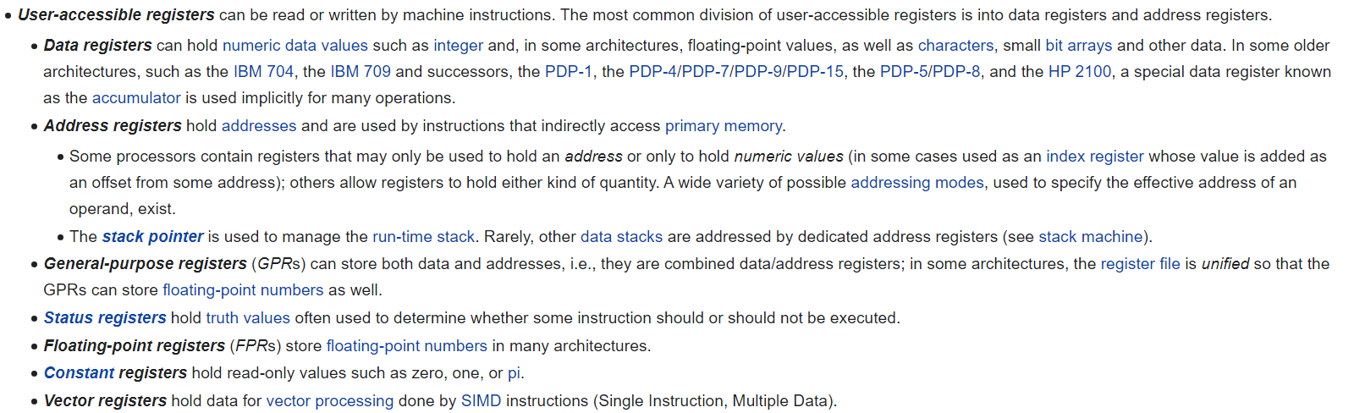
Instruction Set Architecture (Processor)Register: Types
A processor frequently has a variety of register types, which can be categorized based on the values they can store or the instructions that can be executed on them:

Slide 42
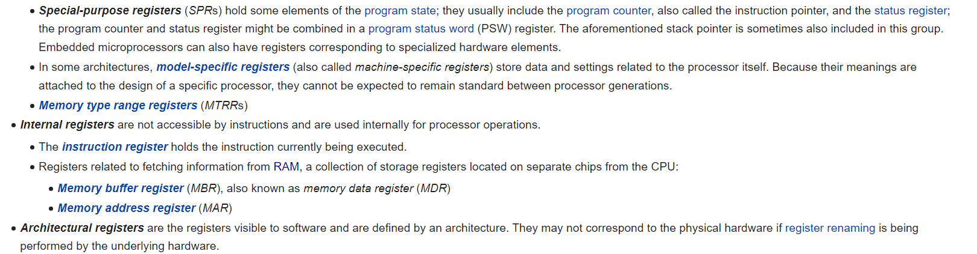
Instruction Set Architecture (Processor)Register: Types

Slide 43
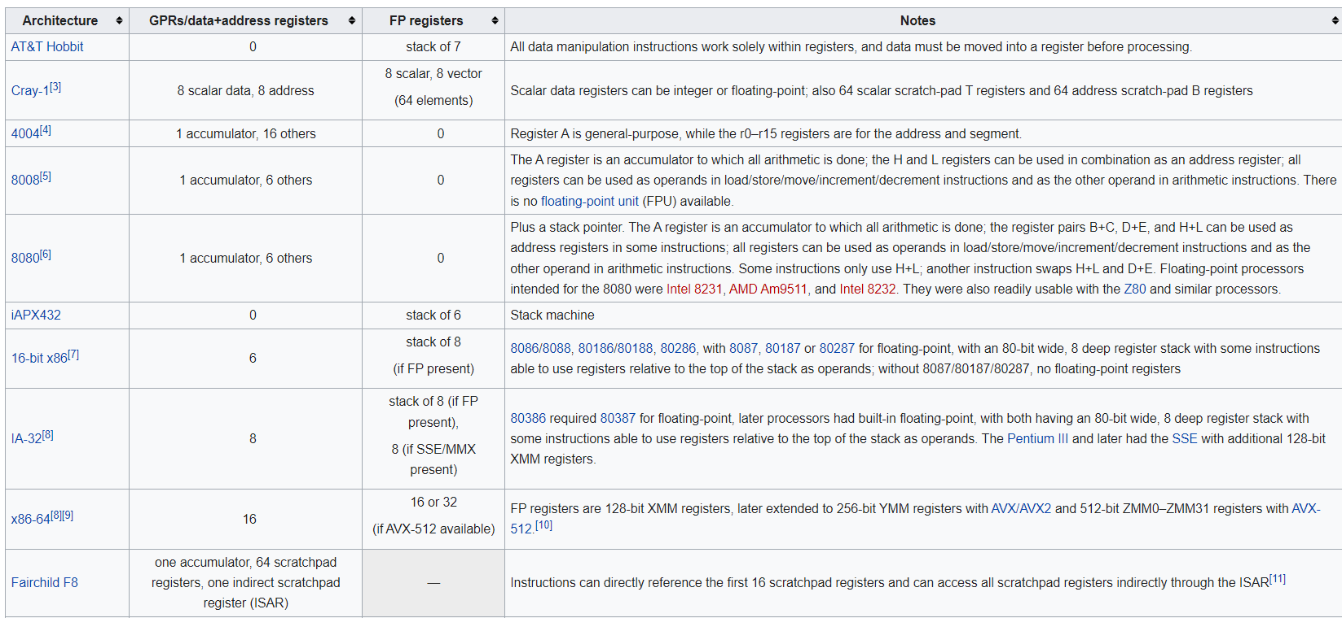
Instruction Set Architecture (Processor)Register: Examples

Slide 44
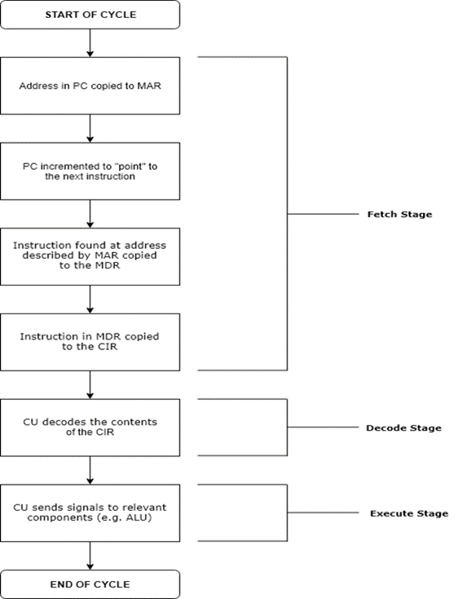
Von Neumann Architecture Instruction Cycle
The instruction cycle (also known as the fetch–decode–execute cycle, or simply the fetch-execute cycle) is the cycle that the central processing unit (CPU) follows from boot-up until the computer has shut down in order to process instructions. It is composed of three main stages: the fetch stage, the decode stage, and the execute stage.
In simpler CPUs, the instruction cycle is executed sequentially, each instruction being processed before the next one is started. In most modern CPUs, the instruction cycles are instead executed concurrently, and often in parallel, through an instruction pipeline: the next instruction starts being processed before the previous instruction has finished, which is possible because the cycle is broken up into separate steps.

Slide 45
Von Neumann Architecture Instruction cycle: Role of components
The memory address of the following instruction to be executed is stored in the program counter (PC), a unique register. In order to "point" to the memory address of the following instruction to be executed, the address contained in the PC is copied into the memory address register (MAR) during the fetch stage. The CPU then transfers the instruction into the memory data register starting at the memory address specified by the MAR (MDR). The memory buffer register (MBR), also known as the MDR, serves as a two-way register that stores data that has been fetched from memory or that is awaiting storage in memory.

Slide 46
Von Neumann Architecture Instruction cycle: Summary of stages
Fetch stage
Decode stage
Execute stage
Repeat cycle

Slide 47
Von Neumann Architecture Instruction cycle: Summary of stages
Each computer's CPU can have different cycles based on different instruction sets, but will be similar to the following cycle:
Fetch stage: The next instruction is fetched from the memory address that is currently stored in the program counter and stored into the instruction register. At the end of the fetch operation, the PC points to the next instruction that will be read at the next cycle.
Decode stage: During this stage, the encoded instruction presented in the instruction register is interpreted by the decoder.
Read the effective address: In the case of a memory instruction (direct or indirect), the execution phase will be during the next clock pulse. If the instruction has an indirect address, the effective address is read from main memory, and any required data is fetched from main memory to be processed and then placed into data registers (clock pulse: T₃). If the instruction is direct, nothing is done during this clock pulse. If this is an I/O instruction or a register instruction, the operation is performed during the clock pulse.
Execute stage: The control unit of the CPU passes the decoded information as a sequence of control signals to the relevant functional units of the CPU to perform the actions required by the instruction, such as reading values from registers, passing them to the ALU to perform mathematical or logic functions on them, and writing the result back to a register. If the ALU is involved, it sends a condition signal back to the CU. The result generated by the operation is stored in the main memory or sent to an output device. Based on the feedback from the ALU, the PC may be updated to a different address from which the next instruction will be fetched.
Repeat cycle
In addition, on most processors interrupts can occur. This will cause the CPU to jump to an interrupt service routine, execute that and then return. In some cases an instruction can be interrupted in the middle, the instruction will have no effect, but will be re-executed after return from the interrupt.

Slide 48
Von Neumann Architecture Instruction cycle: Summary of stages
Fetch Stage
For each instruction, the fetch step is the same: The CPU delivers a read command on the control bus and the contents of the PC to the MAR. The memory returns the data stored at the place indicated by the PC on the data bus in response to the read instruction (with address equal to PC).The CPU copies the information from the data bus into its MDR (sometimes referred to as MBR; see the section above on the components' roles).The CPU copies the information from the MDR to the instruction register for instruction decoding a tiny bit later. The PC is raised in order to point to the subsequent instruction. The CPU is set up for the following cycle at this stage.

Slide 49
Von Neumann Architecture Instruction cycle: Summary of stages
Decode Stage
The CPU can detect what instruction needs to be executed through the decoding process, which also enables it to determine how many operands it needs to fetch in order to execute the instruction. For the subsequent steps, the memory-fetched opcode is decoded and relocated to the relevant registers. Binary decoders in the CPU's control unit normally carry out the decoding. Understanding the actual address[edit]The type of operation that needs to be carried out is determined at this step. If memory is being used, the computer determines whether it is a direct memory operation or an indirect memory operation: Direct memory operation: Null results. Reading the effective address from memory is known as an indirect memory operation.

Slide 50
Von Neumann Architecture Instruction cycle: Summary of stages
Execute Stage
The CPU transmits the decoded instruction to the associated computer parts as a collection of control signals.
The ALU is used if the instruction calls for math or logic.
The instruction cycle's sole phase that the end-user can actually benefit from is this one.
Everything else is overhead that is necessary to carry out the execute phase.

Slide 51
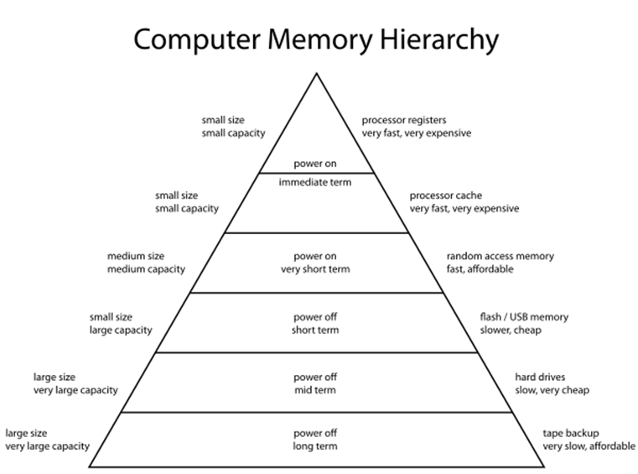
Memory Hirearchy
the memory hierarchy separates computer storage into a hierarchy based on response time.
Since response time, complexity, and capacity are related, the levels may also be distinguished by their performance and controlling technologies.
Memory hierarchy affects performance in computer architectural design, algorithm predictions, and lower level programming constructs involving locality of reference.

Slide 52
Memory Hirearchy
The memory hierarchy in computer architecture categorizes computer storage according to reaction time. Due to the relationships between reaction time, complexity, and capacity, the levels can also be separated based on their performance and regulating methods. Performance in algorithm predictions, lower level programming constructs requiring locality of reference, and computer architectural design are all impacted by memory hierarchy. The size and capabilities of each component must be taken into account while designing for high performance in order to work within the constraints of the memory hierarchy. Each of the different components can be thought of as a member of a hierarchy of memory (m1, m2,..., mn), each of which is smaller and faster than the mi+1 member above it in the hierarchy.

Slide 53
Memory Hirearchy
There are four major storage levels.
Internal – Processor registers and cache.
Main – the system RAM and controller cards.
On-line mass storage – Secondary storage.
Off-line bulk storage – Tertiary and Off-line storage.

Slide 54
Memory Hirearchy
Properties of the technologies in the memory hierarchy
Adding complexity slows down the memory hierarchy.
CMOx memory technology stretches the Flash space in the memory hierarchy
One of the main ways to increase system performance is minimising how far down the memory hierarchy one has to go to manipulate data.
Latency and bandwidth are two metrics associated with caches. Neither of them is uniform, but is specific to a particular component of the memory hierarchy.
Predicting where in the memory hierarchy the data resides is difficult.
the location in the memory hierarchy dictates the time required for the prefetch to occur.

Slide 55
Memory Hirearchy
The quickest access is through the processor registers (usually 1 CPU cycle).
a size of a few thousand bytes A 0 level cache (L0) 6,144 byte micro operations cache (6 KiB [citation needed][original research])[8] in length Level 1 (L1)128 KiB is the size of the instruction cache. Size of [original research]Level 1 (L1) 128 KiB are allocated for data caching. magnitude of [original research]. The ideal access rate is 700 GB/s. [9]Instruction and data at Level 2 (L2), shared, 1 MiB [required citation].magnitude of [original research]. The ideal access rate is about 200 GB/s. [9]Level 3 (L3) 6 MiB for the shared cache[citation needed] magnitude of [original research]. The ideal access rate is about 100 GB/s. [9]Shared cache at Level 4 (L4), 128 MiB [required].magnitude of [original research]. The ideal access rate is about 40 GB/s. [9]

Slide 56
Memory Hirearchy
Main memory (Primary storage) – GiB[citation needed][original research] in size.
Best access speed is around 10 GB/s.^{[9]}
In the case of a NUMA machine, access times may not be uniform
Disk storage (Secondary storage) – Terabytes in size. As of 2017, best access speed is from a consumer solid state drive is about 2000 MB/s^{[10]}
Nearline storage (Tertiary storage) – Up to exabytes in size. As of 2013, best access speed is about 160 MB/s^{[11]}
Offline storage

Slide 57
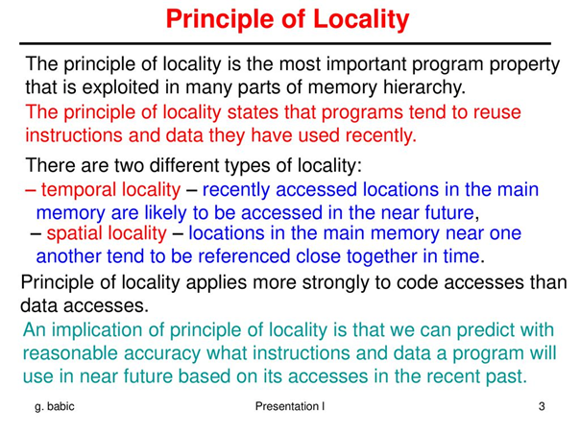
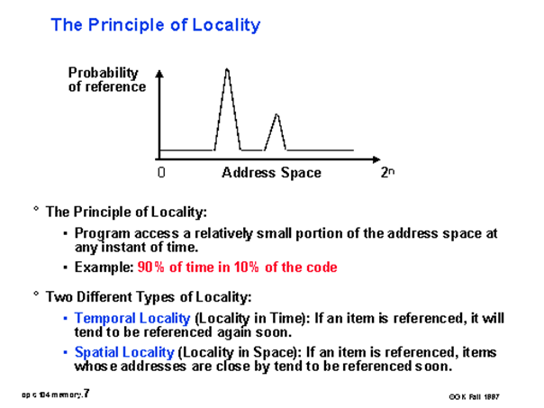
Principle Of Locality

Slide 58
DIFFERENCE BETWEEN RAM & ROM
MY DEAR GREAT TEACHER

Slide 59
RAM
Programs and data that are now being used by the CPU in real-time are stored in random access memory (RAM). Numerous reads, writes, and erases can be made to the data stored in the random access memory.
The data that is now being used is stored in RAM, a component of hardware. Its memory is volatile. Variety of RAM:

Slide 60
RAM
Static RAM, or (SRAM) which stores a bit of data using the state of a six transistor memory cell.
Dynamic RAM, or (DRAM) which stores a bit data using a pair of transistor and capacitor which constitute a DRAM memory cell.

Slide 61
Read Only Memory (ROM)
is a type of memory where the data has been prerecorded. Data stored in ROM is retained even after the computer is turned off ie, non-volatile.

Slide 62
Read Only Memory (ROM)
Programmable ROM, where the data is written after the memory chip has been created. It is non-volatile.
Erasable Programmable ROM, where the data on this non-volatile memory chip can be erased by exposing it to high-intensity UV light.
Electrically Erasable Programmable ROM, where the data on this non-volatile memory chip can be electrically erased using field electron emission.
Mask ROM, in which the data is written during the manufacturing of the memory chip.

Slide 63
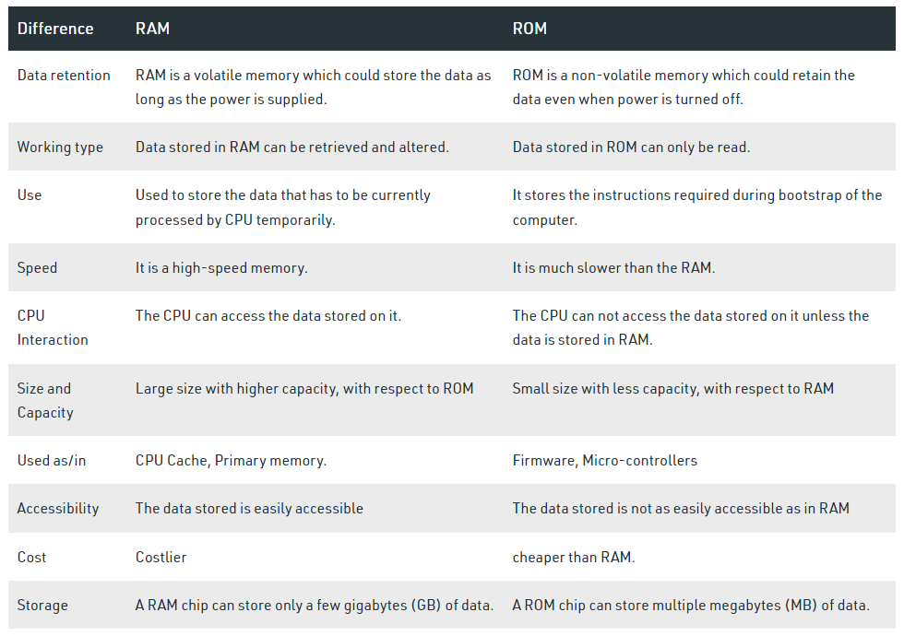
Difference between RAM and ROM
MY DEAR GREAT TEACHER

Slide 64
DIFFERENCE BETWEEN SRAM & DRAM
MY DEAR GREAT TEACHER

Slide 65
What is SRAM?
Random-access memory (RAM) that uses latching circuitry (flip-flops) to store each bit is known as static random-access memory (static RAM or SRAM). SRAM is a volatile form of memory; when the power is cut, data is lost. SRAM (static random-access memory) and DRAM (dynamic random-access memory) are distinguished by the term static because SRAM will retain its data indefinitely in the presence of power while DRAM's data degrades quickly and needs to be updated often. SRAM is often used for the cache and internal registers of a CPU while DRAM is utilized for a computer's main memory. SRAM is quicker than DRAM but costs more in terms of silicon area and cost.

Slide 66
What is DRAM?
Dynamic Random Access memory is a kind of random-access semiconductor memory that stores each bit of information in a memory cell, which normally consists of a small capacitor and a transistor, both of which are typically based on metal-oxide-semiconductor (MOS) technology. While a capacitor and transistor are used in the majority of DRAM memory cell designs, others merely employ two transistors. When a capacitor is employed in a design, it can either be charged or discharged. These two states are considered to represent the two possible values of a bit, which are typically denoted by the numbers 0 and 1. Without intervention, the data on the capacitors would soon be destroyed as the electric charge on them progressively drains away.

Slide 67
Dynamic random-access memory Principles of operation
DRAM is usually arranged in a rectangular array of charge storage cells consisting of one capacitor and transistor per data bit. The figure to the right shows a simple example with a four-by-four cell matrix. Some DRAM matrices are many thousands of cells in height and width.
The long horizontal lines connecting each row are known as word-lines. Each column of cells is composed of two bit-lines, each connected to every other storage cell in the column (the illustration to the right does not include this important detail). They are generally known as the "+" and "−" bit lines.
A sense amplifier is essentially a pair of cross-connected inverters between the bit-lines. The first inverter is connected with input from the + bit-line and output to the − bit-line. The second inverter's input is from the − bit-line with output to the + bit-line. This results in positive feedback which stabilizes after one bit-line is fully at its highest voltage and the other bit-line is at the lowest possible voltage.

Slide 68
Difference between DRAM and SRAM
The fundamental distinction between SRAM and DRAM is that SRAM is an energy-efficient memory chip type that is faster than DRAM. DRAM, on the other hand, is a memory chip that uses more power but can store more data than SRAM. While DRAM is an off-chip memory with a long access time, and is a sort of on-chip memory with a fast access time. SRAM operates better than DRAM as a result.

Slide 69
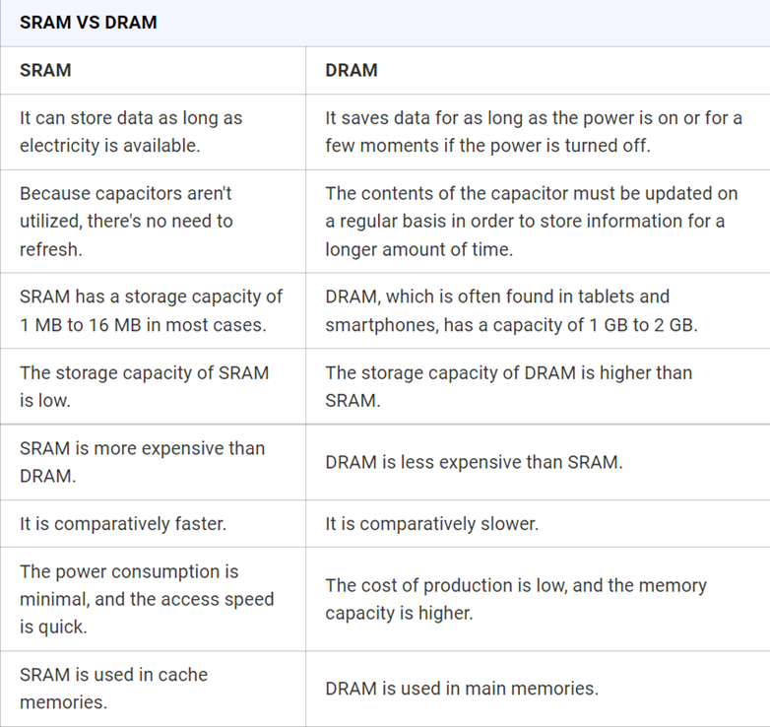
Difference between SRAM and DRAM

Slide 70
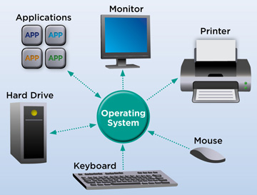
OPERATION SYSTEM

Slide 71
Computer Software: Operating System
What is operation system(OS)
kind of OS:
Service/Function provided by OS
Windows operating system
Linux operating system

Slide 72
What is operation system(OS)?
An operating system (OS) is system software that manages computer hardware, software resources, and provides common services for computer programs.
Time-sharing operating systems schedule tasks for efficient use of the system and may also include accounting software for cost allocation of processor time, mass storage, printing, and other resources.
For hardware functions such as input and output and memory allocation, the operating system acts as an intermediary between programs and the computer hardware,^{[1][2]} although the application code is usually executed directly by the hardware and frequently makes system calls to an OS function or is interrupted by it. Operating systems are found on many devices that contain a computer – from cellular phones and video game consoles to web servers and supercomputers.

Slide 73
Types of Operating System
- Single Tasking and Multi-Tasking - Single and Multi-user - Distributed - Embedded - Real-time - Library

Slide 74
Types of Operating System
Single Tasking and Multi-Tasking
Individual and many tasks A multi-tasking operating system enables multiple programs to run simultaneously, in contrast to a single-tasking system that can only run one program at a time. This is accomplished by time-sharing, in which many processes share the available processor time. An operating system task-scheduling subsystem repeatedly pauses each of these processes in time slices. There are preemptive and cooperative methods of multitasking. Preemptive multitasking divides the CPU time into slots that are assigned to each program by the operating system. Preemptive multitasking is supported by both Unix-like and non-Unix-like operating systems, including Linux and Amiga OS. By relying on each activity to give time to the other processes in a certain way, cooperative multitasking can be accomplished.

Slide 75
Types of Operating System
Single and Multi-user
Dual and multiple users Although many programs may be launched simultaneously in single-user operating systems, there are no capabilities to distinguish users. The basic idea of multitasking is expanded by a multi-user operating system, which also allows numerous users to interact with the system concurrently and provides tools to identify processes and resources, like disk space, that belong to multiple users. Time-sharing operating systems plan tasks to make the most of the system's resources. They may also have accounting software to cost-effectively distribute resources like processing time, mass storage, printing, and other resources across several users.

Slide 76
Types of Operating System
Distributed
Since all computations are spread, a distributed operating system controls a collection of unique, networked computers while making them appear to be a single computer (divided amongst the constituent computers).

Slide 77
Types of Operating System
Embedded
Embedded operating systems are designed to be used in embedded computer systems. They are designed to operate on small machines with less autonomy (e.g. PDAs). They are very compact and extremely efficient by design and are able to operate with a limited amount of resources. Windows CE and Minix 3 are some examples of embedded operating systems.

Slide 78
Types of Operating System
Real-time
A real-time operating system is an operating system that guarantees to process events or data by a specific moment in time. A real-time operating system may be single- or multi-tasking, but when multitasking, it uses specialized scheduling algorithms so that a deterministic nature of behavior is achieved. Such an event-driven system switches between tasks based on their priorities or external events, whereas time-sharing operating systems switch tasks based on clock interrupts.

Slide 79
Types of Operating System
Library
A library operating system is one in which the services that a typical operating system provides, such as networking, are provided in the form of libraries and composed with the application and configuration code to construct a unikernel: a specialized, single address space, machine image that can be deployed to cloud or embedded environments.

Slide 80
Kind of OS
Microsoft Windows, macOS, and Linux are the three most popular desktop operating systems. Graphical user interfaces, or GUIs, are utilized by modern operating systems.

Slide 81
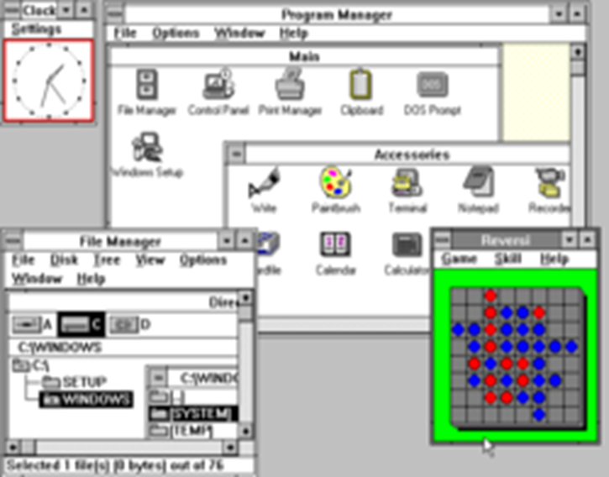
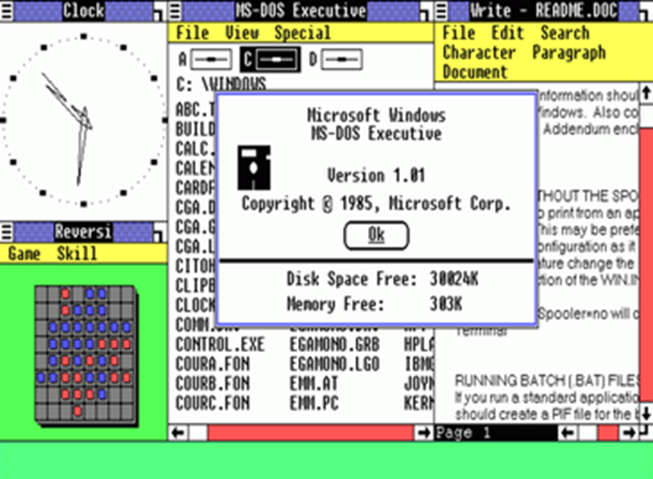
Kind of OS: MICROSOFT WINDOWS
Windows 3.0 released in 1990
Windows 1.0 (first version) released in 1990

Slide 82
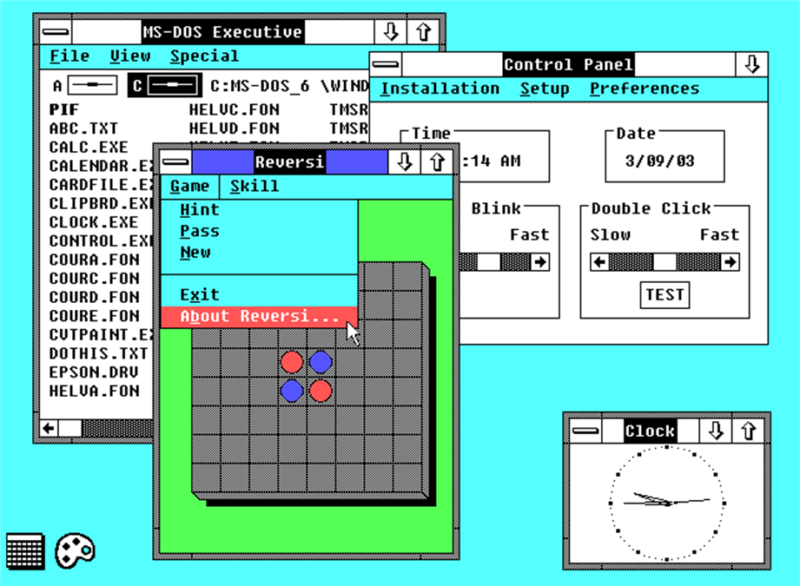
9, December 1987 Microsoft introduced Windows 2.0 in 1987, which was built for the Intel 286 CPU. This update increased graphics compatibility, introduced desktop icons, and provided keyboard shortcuts.
Kind of OS: MICROSOFT WINDOWS

Slide 83
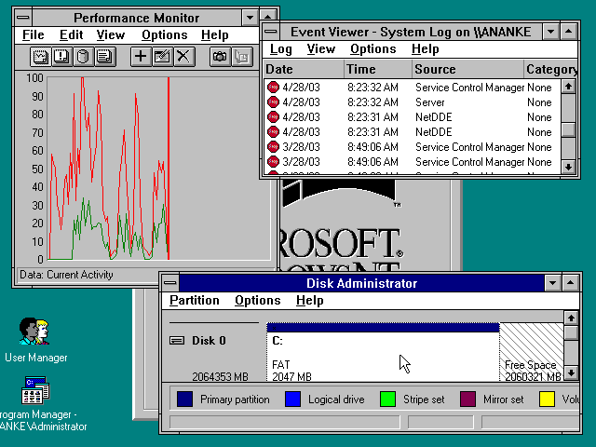
July 27, 1993 Windows NT (New Technology) was a 32-bit operating system that supported preemptive multitasking. There are actually two versions of Windows NT: Windows NT Server, designed to act as a server in networks, and Windows NT Workstation for stand-alone or client workstations.
Kind of OS: MICROSOFT WINDOWS

Slide 84
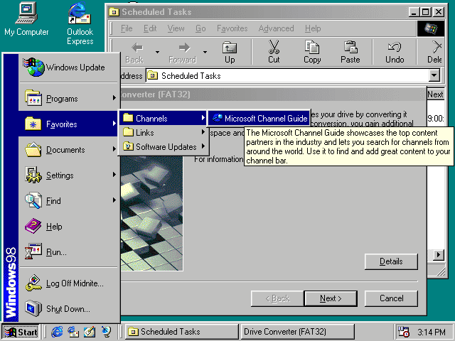
June 25, 1998A number of cutting-edge technologies were supported by Windows 98, including FAT32, AGP, MMX, USB, DVD, and ACPI. The Active Desktop, which incorporated the Web browser (Internet Explorer) with the operating system, was its most noticeable feature, though. Accessing a document that was stored locally on the user's hard drive or on a Web server halfway across the world made no difference from the user's perspective.
Kind of OS: MICROSOFT WINDOWS

Slide 85
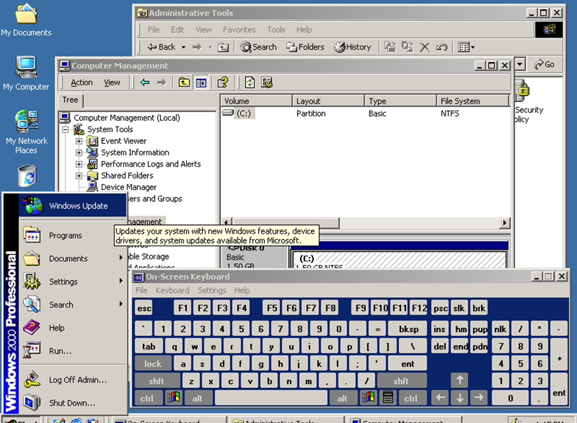
February 17, 2000 Often abbreviated as “W2K,” Windows 2000 was an operating system for business desktop and laptop systems to run software applications, connect to Internet and intranet sites, and access files, printers, and network resources. Microsoft released four versions of Windows 2000: Professional (for business desktop and laptop systems); Server (both a Web server and an office server); Advanced Server (for line-of-business applications); and Datacenter Server (for high-traffic computer networks).
Kind of OS: MICROSOFT WINDOWS

Slide 86
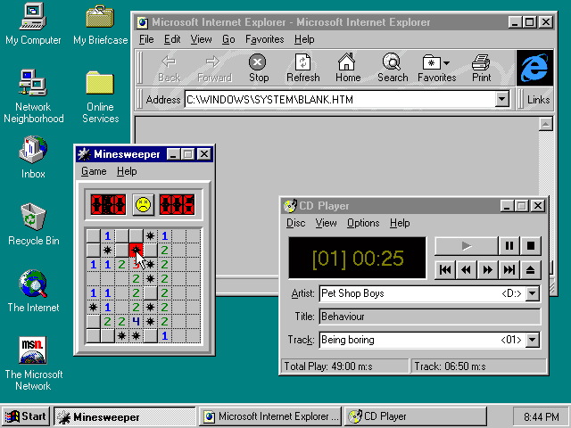
24 August 1995The Windows operating system received a significant boost in Windows 95. This OS was a major improvement over Windows 3.1, which it replaced. Windows 95 included a new user interface in addition to several significant internal upgrades. The fact that it allowed 32-bit applications, which meant that programs created expressly for this operating system would run substantially faster, was arguably its most significant feature.
Kind of OS: MICROSOFT WINDOWS

Slide 87
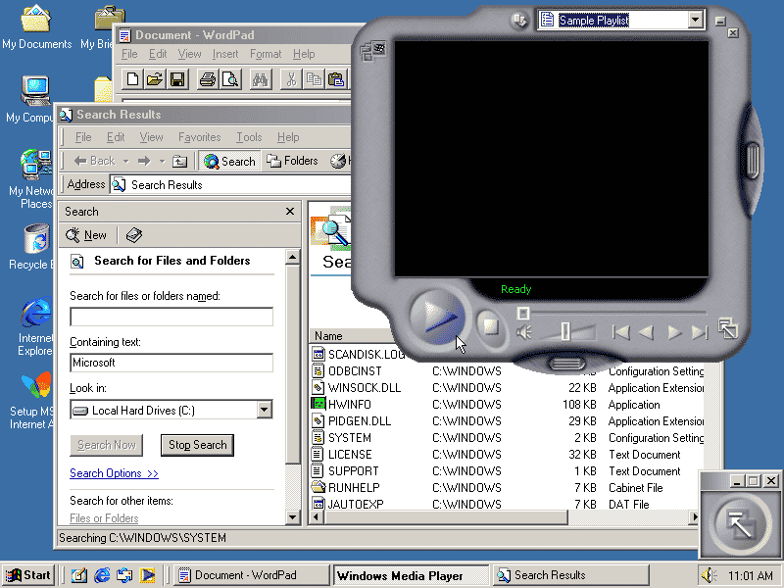
June 19, 2000The Windows 2000 operating system would include some of the features that were part of the Windows Millennium Edition, sometimes known as "Windows Me," which was an update to the Windows 98 core. The "Boot in DOS" option was also eliminated in this version.
Kind of OS: MICROSOFT WINDOWS

Slide 88
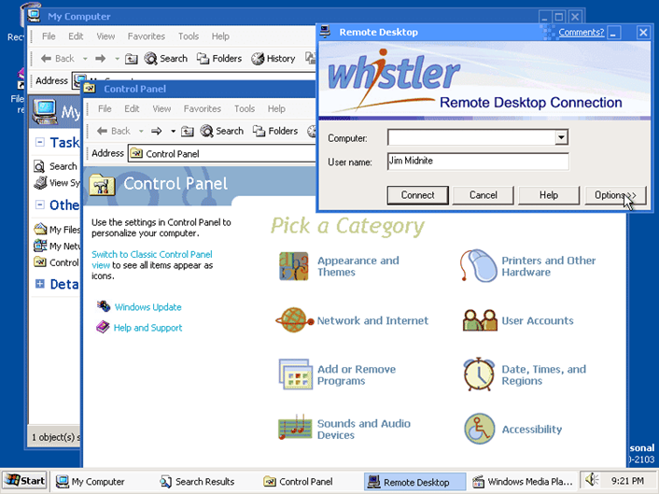
25 October 2001In 2001, Windows XP was made available. The new operating system features a revamped user interface and was based on the Windows 2000 kernel, providing the user with an environment that is more dependable and stable than that of earlier iterations of Windows. There were two editions of Windows XP: Home and Professional. Microsoft prioritized mobility for both editions and built in plug-and-play capabilities for establishing wireless connections. Additionally, the 802.11x wireless security standard was used by the operating system. In the future, Windows XP would rank among Microsoft's best-selling goods.
Kind of OS: MICROSOFT WINDOWS

Slide 89
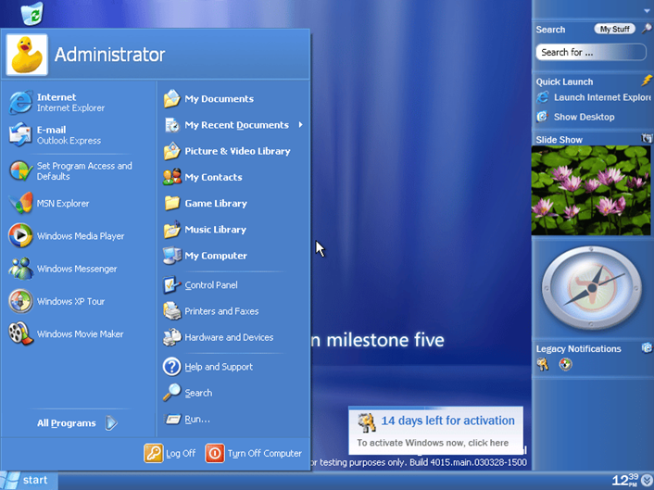
November 30, 2006 (corporate); January 30, 2007 (public) Windows Vista offered an advancement in reliability, security, ease of deployment, performance and manageability over Windows XP. New in this version were capabilities to detect hardware problems before they occurred, security features to protect against the latest generation of threats, a faster start-up time, and low power consumption when placed in the new sleep state. In many cases, Windows Vista was noticeably more responsive than Windows XP on identical hardware. Windows Vista simplified and centralized desktop configuration management, which reduced the cost of keeping systems updated.
Kind of OS: MICROSOFT WINDOWS

Slide 90
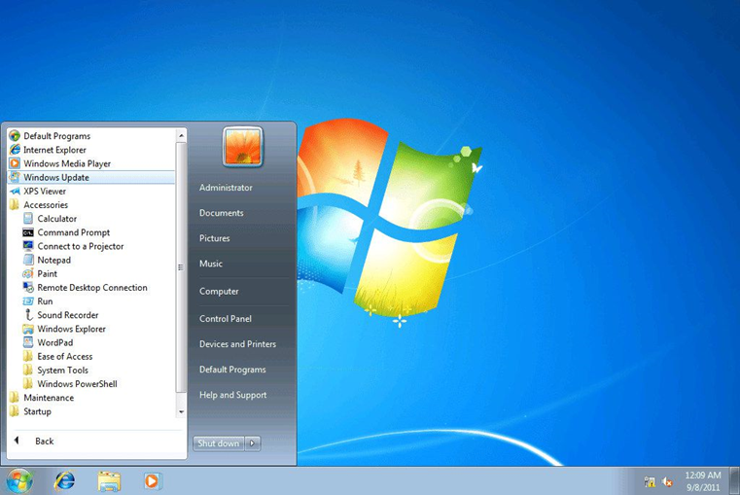
22 October 2009Windows Server 2008 R2, Windows 7's server counterpart, and Windows 7 were both released at the same time. Enhanced performance, a quicker start-up time, Aero Snap, Aero Shake, support for virtual hard disks, a new and greater Windows Media Center, and improved security are just a few of the improvements and new features in Windows 7.
Kind of OS: MICROSOFT WINDOWS

Slide 91
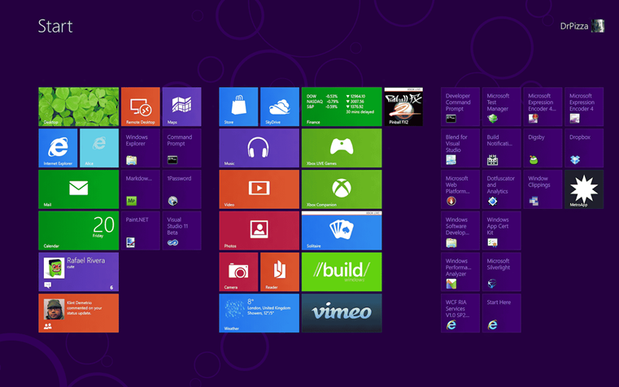
26 October 2012A Windows 8 PC may load and start up in a couple of seconds rather than taking several minutes thanks to the operating system's near-instant-on capabilities and complete redesign with touchscreen use in mind.A new "Metro" design system interface, initially seen in the Windows Phone 7 mobile operating system, supplanted the more conventional Microsoft Windows OS look and feel with Windows 8. The "Start screen" of the Metro user interface was made up mostly of "Live Tiles," which connected to dynamic, continuously updated features and applications. ARM and x86 PCs were both supported by Windows 8.
Kind of OS: MICROSOFT WINDOWS

Slide 92
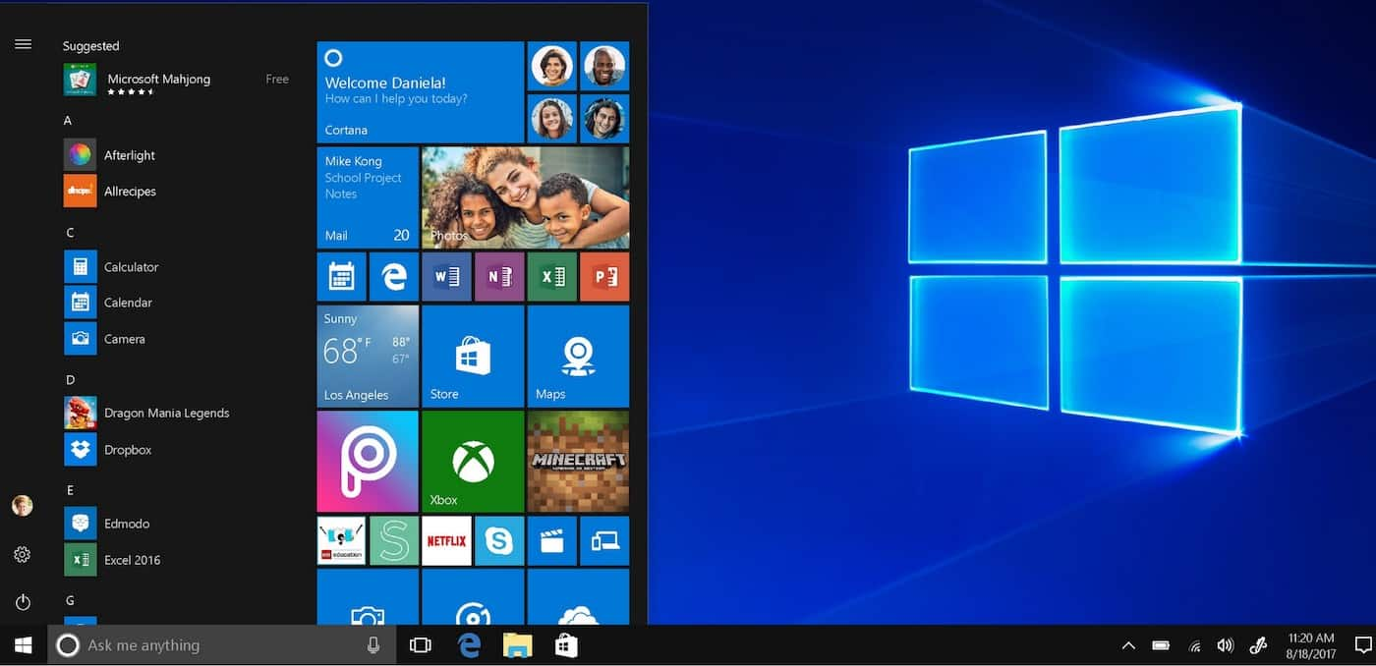
July 29, 2015The replacement for Windows 8 was Windows 10. After a "technical preview" beta release of the new operating system (Fall 2014) and a "consumer preview" beta, Windows 10 made its official debut on July 29, 2015. (Early 2015). Fast start-up and resume times, integrated security, and the larger Start Menu were all features of Windows 10. The new Microsoft Edge browser was also included with this edition of Windows. Any eligible device, including those running a pirated version of Windows, could upgrade to Windows 10 (including tablets, PCs, cellphones, and Xbox consoles).
Kind of OS: MICROSOFT WINDOWS

Slide 93
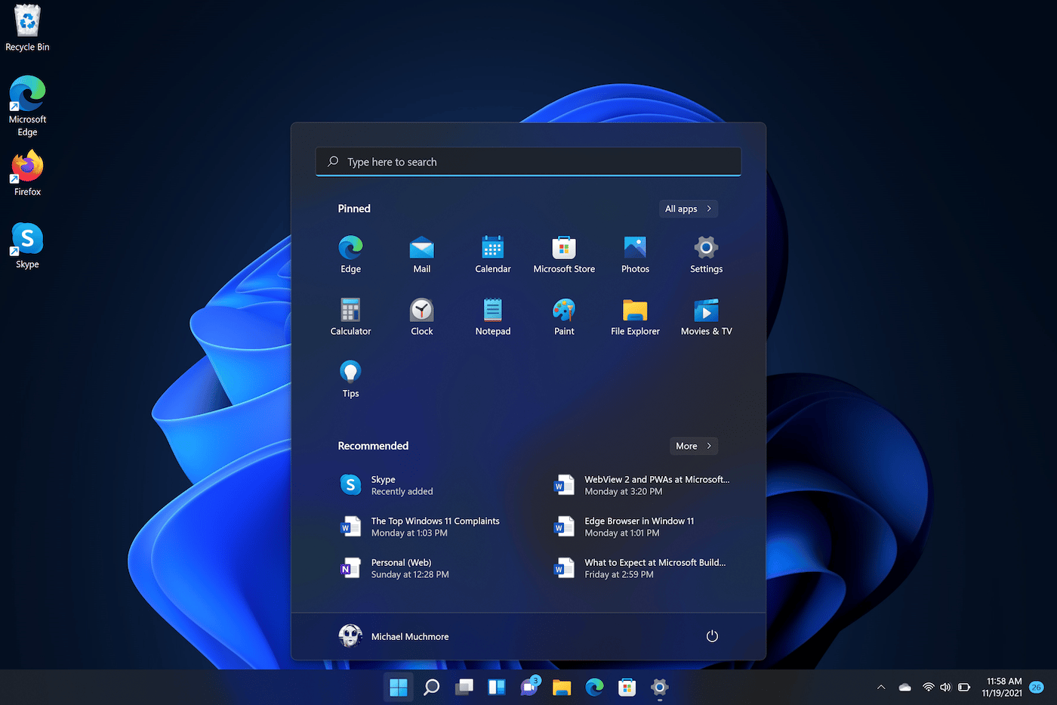
five october 2021Despite Microsoft's insistence that Windows 10 would be the final iteration of the operating system, Windows 11 added a fresh visual aesthetic, updated software, touchscreen optimizations, and multitasking capabilities. Microsoft further asserts that Windows 11 is the most secure version to date. As long as their computer satisfies the system requirements, current Windows 10 users will be able to upgrade to Windows 11 for free.
Kind of OS: MICROSOFT WINDOWS

Slide 94
What is Microsoft windows?
Microsoft created and distributes a number of proprietary graphical operating system families under the name Windows. Each family serves a particular segment of the computer industry. Windows NT for end users, Windows Server for servers, and Windows IoT for embedded systems are a few examples. Windows 9x, Windows Mobile, and Windows Phone are among the defunct Windows family. In response to the rising demand for graphical user interfaces, the first version of Windows was published on November 20, 1985, as a graphical operating system shell for MS-DOS (GUIs).According to Stat Counter, Windows had a 75% market share for desktop operating systems worldwide as of April 2022.However, due to Android's popularity, Windows is not the most popular operating system when considering both desktop and mobile OSes.

Slide 95
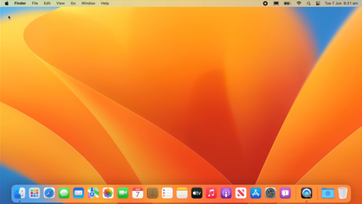
macOS

Slide 96
What is macOS?
Since 2001, Apple Inc. has created and marketed macOS, a Unix operating system (/maekos/; formerly OS X and initially Mac OS X). It serves as the main operating system for Mac computers made by Apple. It is the second-most popular desktop operating system in the market for desktop and laptop computers, after ChromeOS and ahead of Microsoft Windows. The classic Mac OS, a Mac operating system with nine editions between 1984 and 1999, was replaced by macOS. Steve Jobs, a co-founder of Apple, had founded NeXT while working on the NeXTSTEP platform, which would later be purchased by Apple and serve as the foundation for macOS.

Slide 97
macOS: Development
The heritage of what would become macOS had originated at NeXT, a company founded by Steve Jobs following his departure from Apple in 1985. There, the Unix-like NeXTSTEP operating system was developed, before being launched in 1989. The kernel of NeXTSTEP is based upon the Mach kernel, which was originally developed at Carnegie Mellon University, with additional kernel layers and low-level user space code derived from parts of BSD. Its graphical user interface was built on top of an object-oriented GUI toolkit using the Objective-C programming language.
Throughout the early 1990s, Apple had tried to create a "next-generation" OS to succeed its classic Mac OS through the Taligent, Copland and Gershwin projects, but all were eventually abandoned. This led Apple to purchase NeXT in 1996, allowing NeXTSTEP, then called OPENSTEP, to serve as the basis for Apple's next generation operating system. This purchase also led to Steve Jobs returning to Apple as an interim, and then the permanent CEO, shepherding the transformation of the programmer-friendly OPENSTEP into a system that would be adopted by Apple's primary market of home users and creative professionals. The project was first code named "Rhapsody" and then officially named Mac OS X
.

Slide 98
Mac OS X
Up until 2020, releases of macOS kept the main version number "10," with Mac OS X being the tenth major release of Apple's operating system for Macintosh computers. According to Apple, the letter "X" in the name Mac OS X stands for the Roman numeral 10, and in this context, it should be pronounced "ten." But it's also frequently pronounced as the letter "X." Arabic numerals were used in the names of earlier Macintosh operating systems (versions of the original Mac OS), such as Mac OS 8 and Mac OS 9.

Slide 99
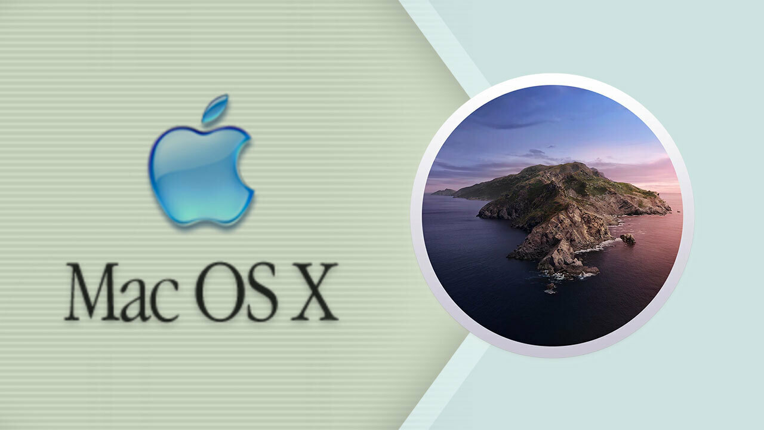

Slide 100
OS X
The name of the operating system was formally abbreviated from Mac OS X to OS X in 2012 with the introduction of OS X 10.8 Mountain Lion, after the previous version had done so in a similar way the year before. In that same year, Apple fired Scott Forstall, the director of OS X development, and the design was altered in favor of a simpler aesthetic. [41] With the release of iOS 7 in 2013, Apple introduced a new user interface style that used intense color saturation, text-only buttons, and a simple, "flat" UI. The 2013 release of OS X 10.9 Mavericks was somewhat of a transitional edition, with some of the skeuomorphic design removed but the majority of the overall Mavericks interface remaining. OS X engineers were apparently working on iOS 7.

Slide 101
macOS: Architecture
A POSIX-compliant operating system built on top of the XNU kernel,[55] with common Unix features accessible via the command line interface, forms the basis of macOS. This software family was made available by Apple as the Darwin operating system, which is free and open source. To finish the GUI-based operating system known as macOS, Apple placed a number of components, including as the Aqua user interface and the Finder, on top of Darwin. The system's initial release as Mac OS X included a number of new features that made it a more dependable and stable platform than the previous Mac OS. Pre-emptive multitasking and memory protection, for instance, enhanced the system's capacity to run several applications concurrently without them interfering with or corrupting one another.

Slide 102
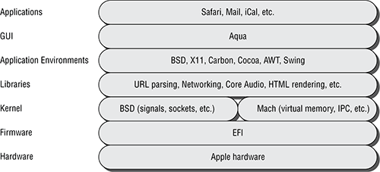
S

Slide 103
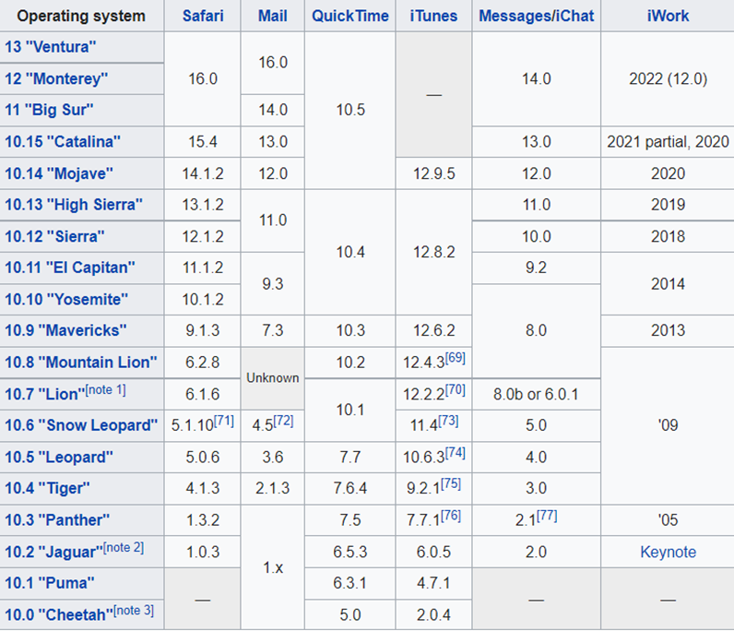
macOS: Software Compatability

Slide 104
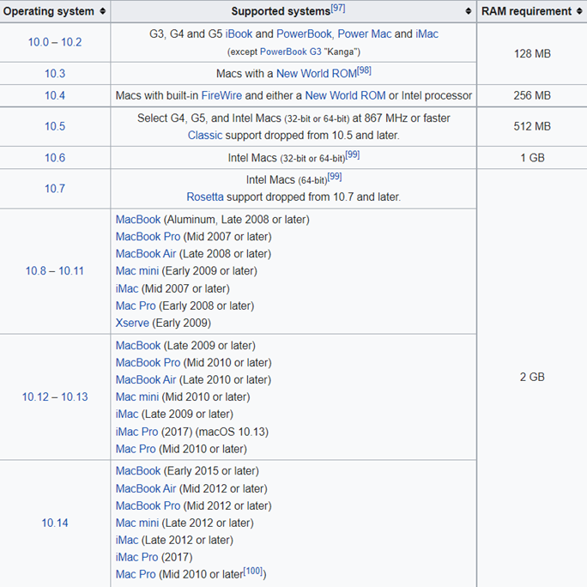
macOS: Hardware Compatability

